Slide 1

WELCOME
TO
LIBRARY MANAGEMENT SYSTEM
Prepared by:
Name: Pramod Yadav
Roll no.: 2216260

Slide 2

CONTENTS
Introduction
Purpose
Project Scope
Users of the system
Functional Requirements
Tools to be used
Front end and Back end
How to project work?
Safety Requirements

Slide 3


INTRODUCTION
The “Library Management System” is developed in java Swing for front end and using Mysql for the back end, which is manly focus on the basic working in a library such as adding librarian, new books, updating the information, searching books and members and facility to issue and return books. Using this application user can make the booking of books and can look either it is available in library or not.

Slide 4

Purpose
It provides “better and efficient” services to the students
Reduce the workload of librarian.
Fastest retrieval of information about the desired book.
Provide facility for proper monitoring reduce paper work and provide the data security.
All details will available on a click.

Slide 5
Project Scope
Any education institute & government office’s can make use of it for providing information about author, content of the available book etc.…
This project can further be extended by adding the facility of e-book's to overcome the problem of book stock in library.

Slide 6


User of the System
Admin
Librarian
Remarks:
The users have the sufficient knowledge of computers & of English language, as the user interface will be provided in English.

Slide 7

Functional Requirements
1. Admin
Can add/view/delete librarian
Can logout
2. Librarian:
Can add/view books
Can issue books
View issued books
Return books
Can logout

Slide 8
Tools to be used
Hardware REQUIREMENT
Operating System: windows
Hard disk: 40 GB
RAM: 256 MB
Processor: intel core i3
SOFTWARE REQUIREMENT
To develop the project use any IDE. It may be Eclipse/MyEclipse/NetBeans etc.
Mysql Workbench for the database.

Slide 9
Front end and Back end
Front end: Java Swing
Back end: Mysql

Slide 10
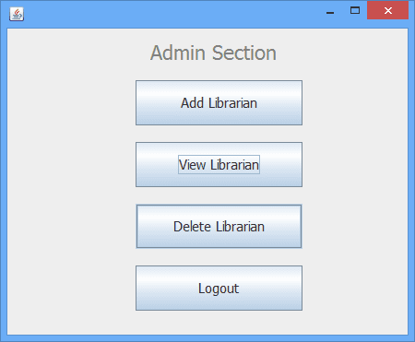
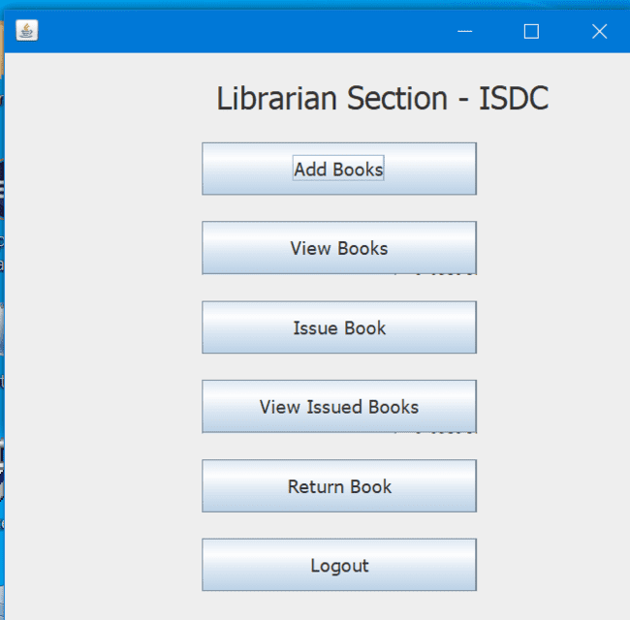
How project works ?
Firstly login admin and librarian and then operate all the operations which are given in the options also get references from the following screenshots

Slide 11
SAFETY REQUIREMENT
The database may get crashed at any certain time due to virus or operating system failure. Therefore, it is required to take the database backup.

Slide 12


THANK YOU….
“If I cannot do great things, I can do small things in a great way.”

